Slide 1
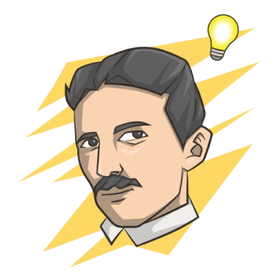
ECHO
Mekić
Lončarski

Slide 2
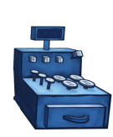
KASA
Web Api Projekat
Aplikacija za upravljanje kupovinom

Slide 3
PRIMENJENE TEHNOLOGIJE
.NET 6
Auto Mapper
C# 10
Fluent Validation
SQL Server
MediatR
MSTest
Docker

Slide 4
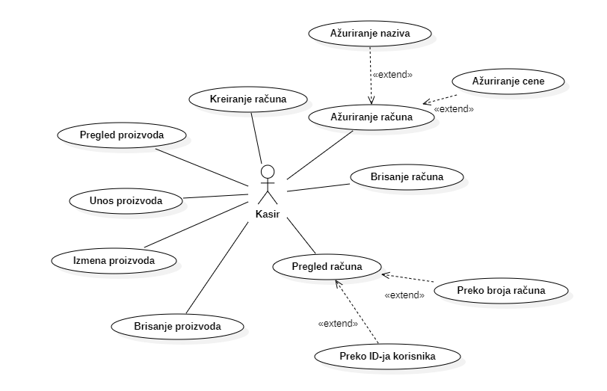
SLUČAJEVI KORIŠĆENJA

Slide 5
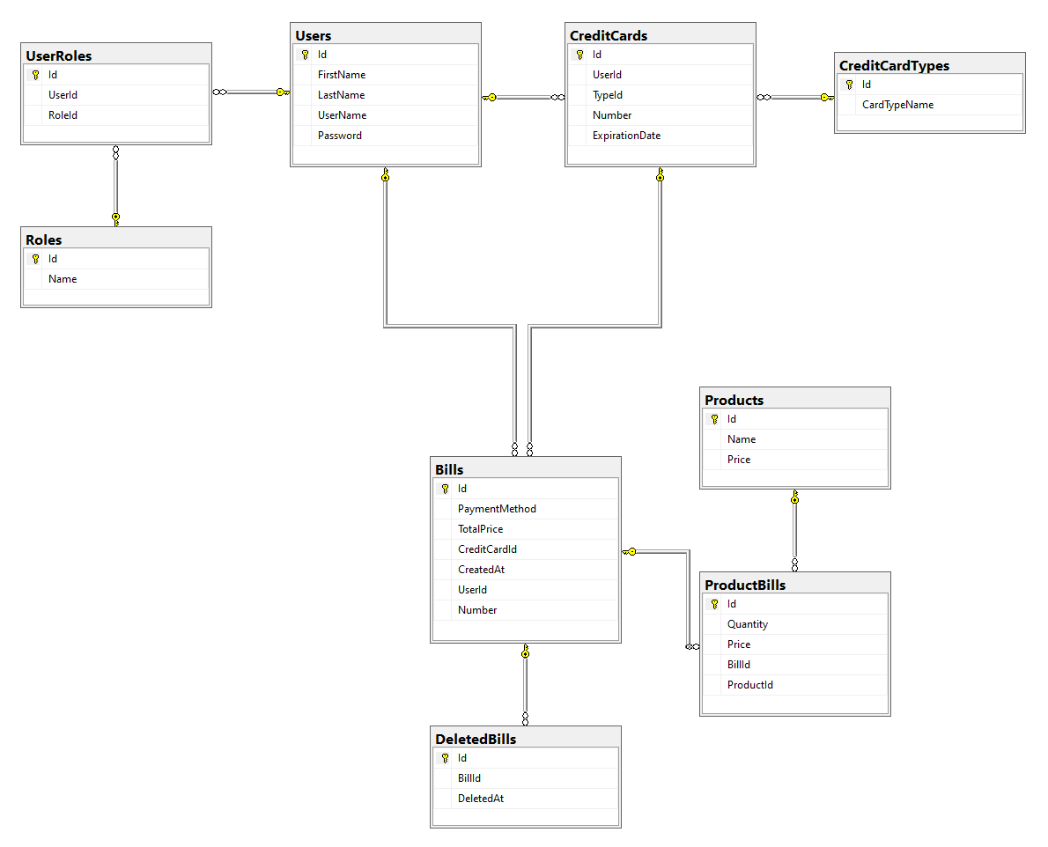

Slide 6
GENERISANJE BROJA RAČUNA - ISO 7064 model 97
public string GenerateBillNumber(long identificationCode, long billSequence)
{
var basePart = $"{identificationCode:D3}{billSequence:D13}";
var baseNumber = long.Parse(basePart);
var controlNumberCalculation = (baseNumber * 100) % 97;
var controlNumber = 98 - (int)controlNumberCalculation;
return $"{identificationCode:D3}-{billSequence:D13}-{controlNumber:D2}";
}
123-0000000000001-42
public long GenerateIdentificationCodeBasedOnDateTime()
{
var now = DateTime.Now;
var dayOfYear = now.DayOfYear;
var hour = now.Hour;
var minute = now.Minute;
var second = now.Second;
long code = dayOfYear * (hour + 1) * (minute + 1) * (second + 1) % 900 + 100;
return code;
}

Slide 7
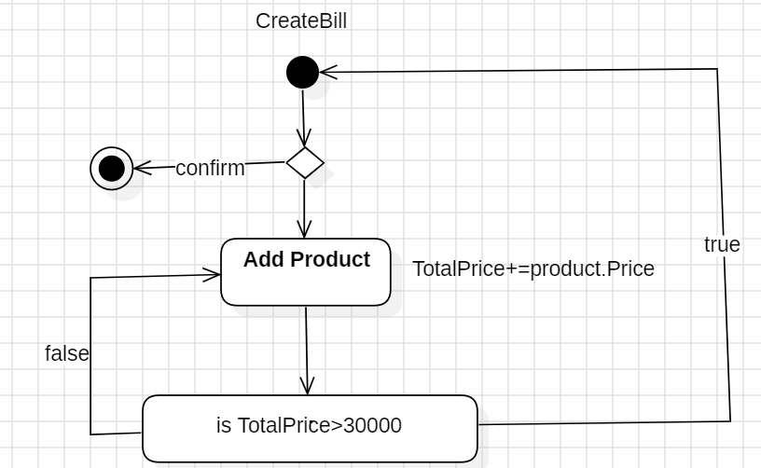
KREIRANJE RAČUNA
Create a new instance of BillNumberService
Create a new instance of BillManager with (userId, paymentMethod, creditCardId, currencyManager, currency, billNumberService)
For each productDto in request.Products
Find product by productDto.ProductId
If product not found
Throw ArgumentException("Product not found.")
Add product to bill using billManager.AddProductToBill(product, quantity)
Finish billing to get list of bills with billManager.FinishBilling()
Add bills to bill repository
Return bills

Slide 8
UNIT TEST
Test GenerateBillNumber_ReturnsCorrectFormat
// Arrange
Create billNumberService instance
Set identificationCode to 123
Set billSequence to 1
// Act
Generate bill number using billNumberService.GenerateBillNumber(identificationCode, billSequence)
// Assert
Assert that the result matches the regex pattern "^\d{3}-\d{13}-\d{2}$"

Slide 9
ZAKLJUČAK
Doprinos
Realizovani korisnički zahtevi
Sigurnost - Algoritmi validacije
Razumevanje korišćenih tehnologija
Potencijalna poboljšanja
Struktura projekta
Enkripcija podataka
Personalizacija – mašinsko učenje

Slide 10
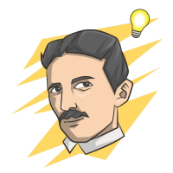
HVALA NA PAŽNJI
Pitanja?
ECHO
Nikola Mekić/Lončarski

