Slide 1
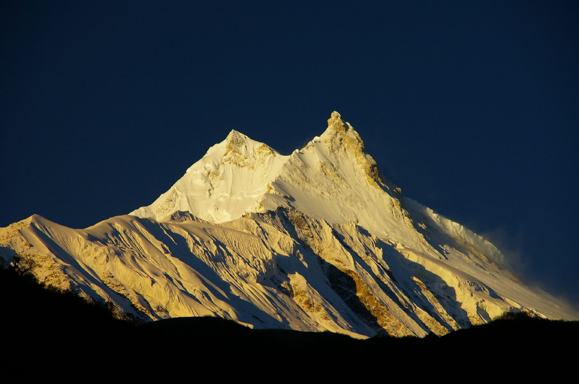
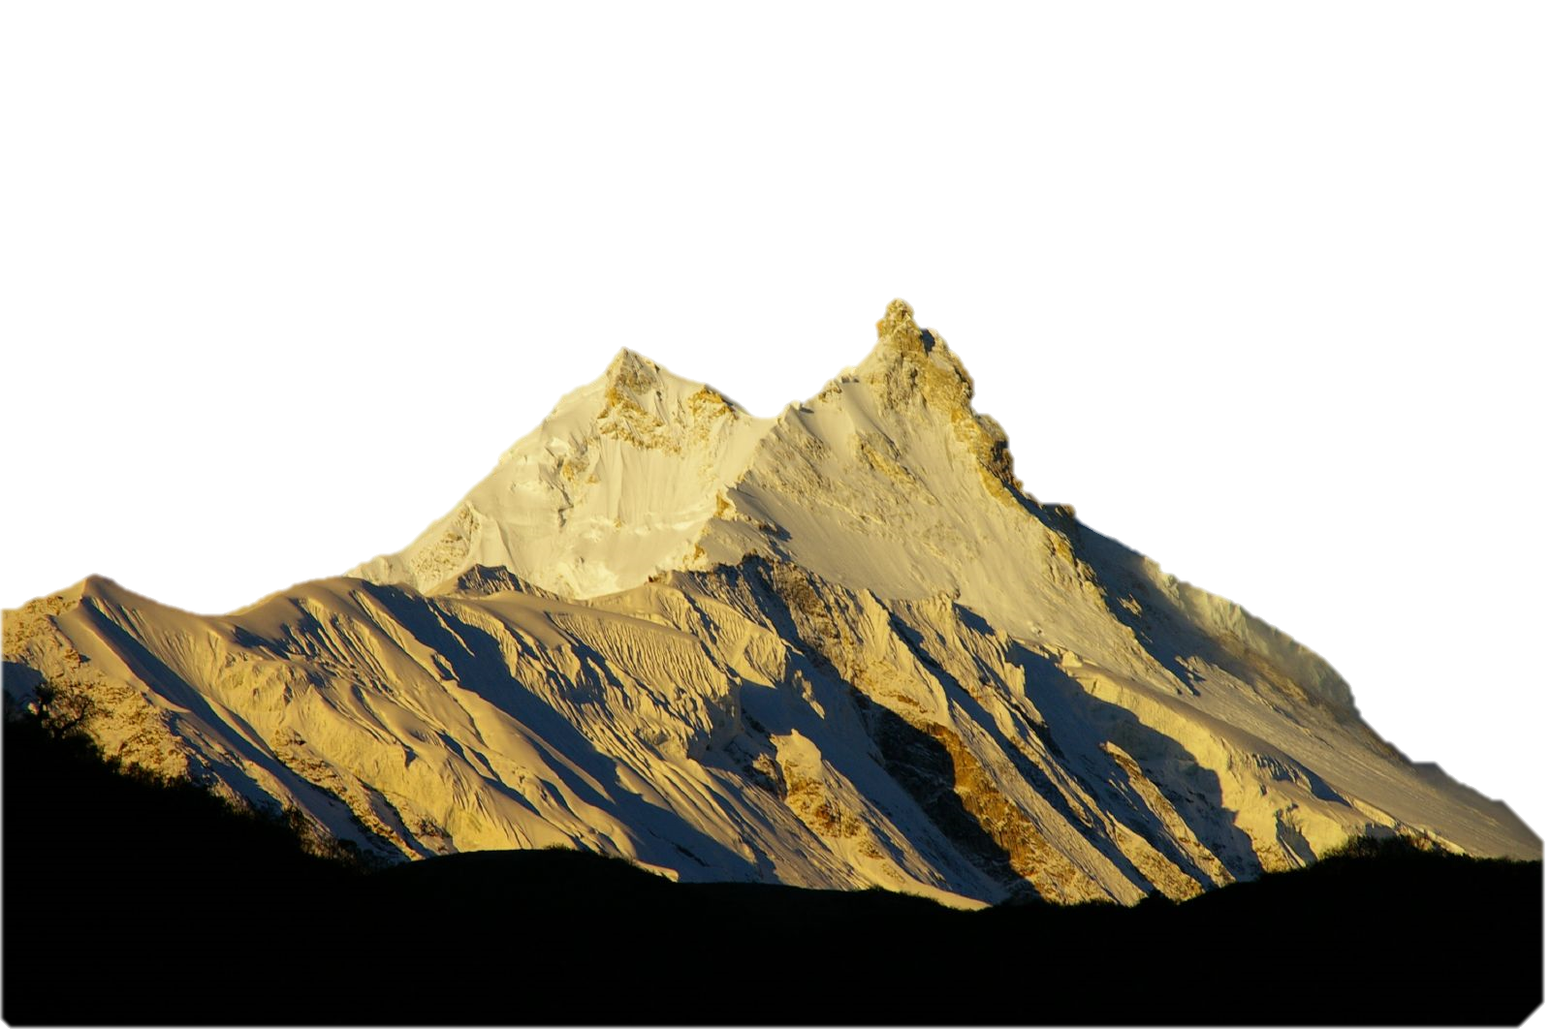
Nikola Mekić, Aleksa Miskin, Husein Marić, Ena Omanović, Anđela Veljović, Tijana Milivojević, Jernej Belcl
MANASLU
Platform Engineering
2023.

Slide 2
Introduction
Nikola Mekić
Aleksa Miskin
Husein Marić
Ena Omanović
Anđela Veljović
Tijana Milivojević
Jernej Belcl
Marko Rupnik, Luka Kidrič

Slide 3
Establish a scalable, secure, and efficient infrastructure on the AWS platform,
Implement a Kubernetes cluster,
Implement PostgreSQL database, and
integrating Prometheus and Grafana tools for monitoring and managing applications within the cluster.
GOAL

Slide 4
Setting Up the AWS Infrastructure:
Create VPC
Create Public and Private Subnets
NAT Gateway and Internet Gateway
Route Tables Configuration
TERRAFORM
UBUNTU

Slide 5
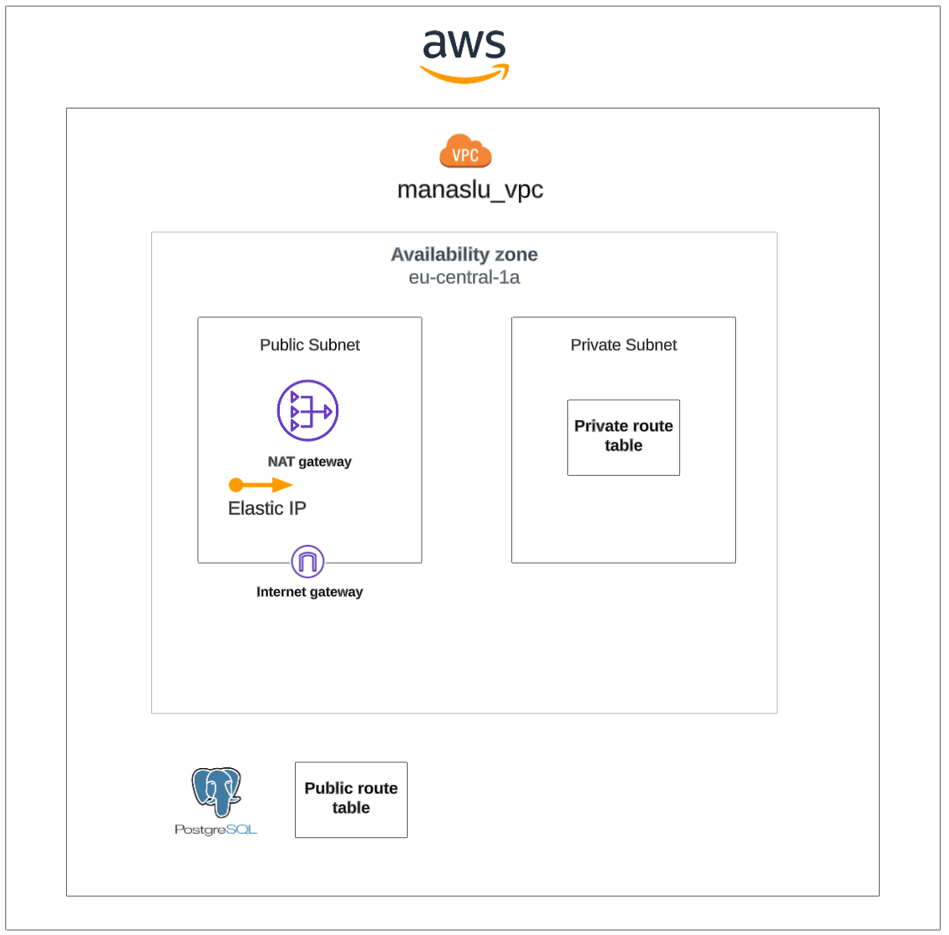
02.
06.

Slide 6
Provisioning PostgreSQL
Database and EKS Cluster:
01.
Create PostgreSQL Database using Terraform
Expose the Database
Managing DB Variables with Terraform
Securely Managing the DB Password
TERRAFORM
UBUNTU

Slide 7
Implementing Autoscaling
and EKS Cluster Features:
Autoscaling Groups (ASG)
Provisioning EKS Cluster
K8s Autoscaler Configuration
Installing Metrics Server
TERRAFORM
UBUNTU

Slide 8
Deploying Prometheus & Grafana for Monitoring:
01.
TERRAFORM
Deploy Prometheus & Grafana via Helm
Configuring Prometheus as Data Source
Adding Grafana Dashboards
UBUNTU

Slide 9
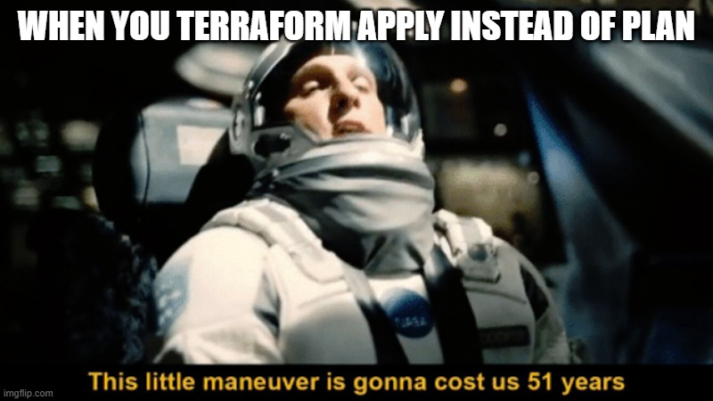
Conclusion

Slide 10
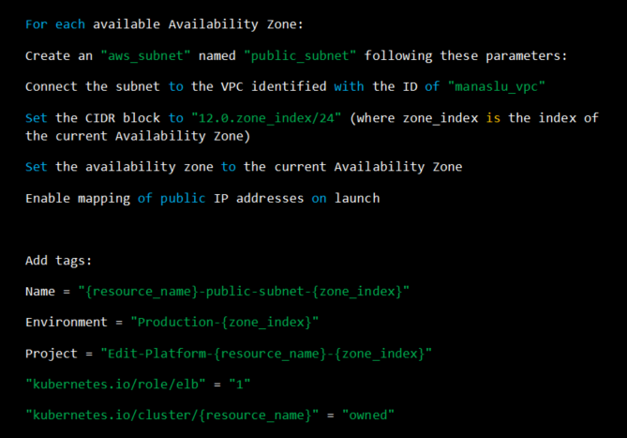
Public subnet

Slide 11
Q&A

